Slide 1
BASIC PROFESSIONAL TRAINING COURSE
Module 21-P1
Name of Lecturer
Organization
Email address

Slide 2
BASIC PROFESSIONAL TRAINING COURSE
Leadership, Management for Safety and Safety Culture
Integrated Management Systems
This material was prepared by the IAEA and co-funded by the European Union.

Slide 3
Contents
Introduction
IAEA Safety Standards
SSG-16 Overview for establishing a Safety Infrastructure
Leadership, Management for Safety and Safety Culture
Integrated Management System
SF
GSGs
SSRs
GSGs
SSG
07-18 May - 18-29 June 2018

Slide 4
Learning objectives
Integrated Management Systems
After completing this chapter from Module 21, the trainee will be able to:
Understand the relevant IAEA Safety Standards related to leadership, management for safety and safety culture for establishing safety infrastructure for nuclear power program
Describe the concept of an Integrated Management System
Describe what an organization needs to consider when implementing Integrated Management System
07-18 May - 18-29 June 2018

Slide 5
Introduction
Introductory remarks if needed
Name of Lecturer
Organization
Experience
Email address
The objective of this presentation is to give an introduction to the IAEA approach on the Integrated Management System and guidance for implementing the requirements.
07-18 May - 18-29 June 2018
Notes:
The Lecturer would introduce him/her self mentioning qualification and relevant experience in the area of nuclear safety
He/She is encouraged to prepare a short introduction (maximum 5 minutes/lecturer) during the opening part of each week. Topics of this introduction should cover personal experiences, national nuclear program, national legal framework, and information on the regulatory body as time permits.

Slide 6
Introduction
Need for Implementation of Management System
decision to launch a nuclear power programme implies a governmental commitment at national and international levels;
it requires establishment of a legal and governmental infrastructure with an independent regulatory system;
which ensures that nuclear facilities and materials are handled and operated safely and securely fulfilling the international safety obligations;
to ensure that regulatory functions are managed effectively and efficiently in an integrated and coherent manner, the regulatory body has to implement the management system;
regulatory body has to implement the requirements set out in the Safety Standards “Leadership and Management for Safety (GSR Part 2)” in order to perform its functions effectively and efficiently;
regulatory body needs to fully integrate the human resources, processes and physical resources of the organization to maintain a high level of performance in regulating facilities and activities.
07-18 May - 18-29 June 2018
Notes:
Responsibilities for the effectiveness of the management system should not be delegated.
Safety is paramount and there is a single framework to address all the factors (Safety, security, safeguards, health, environment etc.) together at the same time.

Slide 7
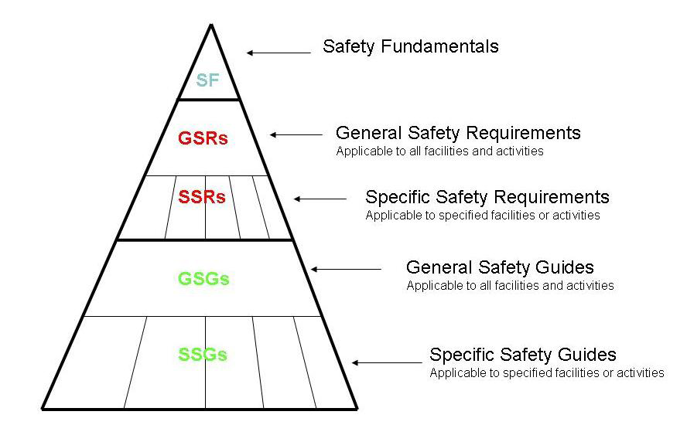
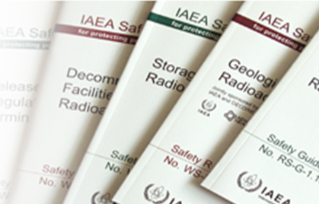
IAEA Safety Standards
Recap
A global reference for protecting people and the environment
Notes:
The aim of the set of Safety Standards is to provide requirements and guidance for implementing an effective Management System that:
Integrates all aspect of managing functions and activities including the safety, health, quality and environmental requirements in a coherent manner. This integration aims to ensure that economic, environmental, health, security and quality matters are not considered separately to safety matters, to avoid any potential negative impact on safety. The three main documents in the IAEA Safety Standards that relate to management systems are:
Safety Requirements GSR Part 2 which specifies the requirements for Leadership for safety, Management System and safety culture for all nuclear installations and activities, Safety Guide GS-G-3.1 which provides thematic guidance for each of the requirements contained in GSR Part 2 and is applicable to all nuclear facilities and activities. Safety Guide GS-G-3.5 which provides specific guidance for Management Systems for nuclear facilities.

Slide 8

IAEA Safety Standards
Principle 1.
Responsibility
For Safety
Principle 7.
Protective Actions to
Reduce Existing or
Unregulated Radiation
Risks
Principle 2.
Role of Government
Principle 8.
Emergency
Preparedness and
Response
Principle 3.
Leadership and
Management for
Safety
Principle 9.
Prevention of Accidents
Principle 4.
Justification of
Facilities and
Activities
Principle 5.
Optimization of
Protection
Principle 6.
Limitation of
Risks to
Individuals
Principle 10.
Protection of Present
And Future Generations
07-18 May - 18-29 June 2018
Notes:
[From SF-1 |Principle 3] Principle 3 of the IAEA’s Fundamental Safety Principles, on Leadership and Management for Safety, states that “Effective leadership and management for safety must be established and sustained in organizations concerned with, and facilities and activities that give rise to, radiation risks.”
8

Slide 9
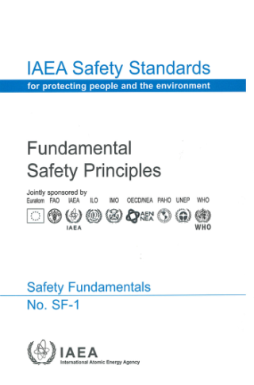
Fundamental Safety Principles
IAEA Safety Standards
Principle 1: Responsibility for safety must rest with the person or organization responsible for facilities and activities that give rise to radiation risks.
Principle 3: “Effective leadership and management for safety must be established and sustained in organizations concerned with, and facilities and activities that give rise to, radiation risks.”
  3.12...Safety has to be achieved and maintained by means of an
  effective management system which integrates all elements of
  management so that requirements for safety are established and applied
  coherently with other requirements……
  3.14. An important factor in a management system is the recognition of the entire range of interactions of individuals at all levels with technology and with organizations……
07-18 May - 18-29 June 2018
Notes:
[From SF-1 |Principle 3] Principle 3 of the IAEA’s Fundamental Safety Principles, on Leadership and Management for Safety, states that “Effective leadership and management for safety must be established and sustained in organizations concerned with, and facilities and activities that give rise to, radiation risks.”
3.12 ……..Safety has to be achieved and maintained by means of an effective management system which integrates all elements of management so that requirements for safety are established and applied coherently with other requirements, including those for human performance, quality and security, and so that safety is not compromised by other requirements or demands. The management system also has to ensure the promotion of a safety culture, the regular assessment of safety performance and the application of lessons learned from experience.
3.14. An important factor in a management system is the recognition of the entire range of interactions of individuals at all levels with technology and with organizations……
This principle also applies to regulatory body Also refer to GSR Part 2, Req. 2

Slide 10
IAEA Safety Standards
Evolution to Management Systems
Systemic approach
GSR Part 2
2016
(Integrated)
Management
Systems
Safety & Performance
GS-R-3
2006
Quality Management
50-C-Q
1996
Quality Assurance
Quality Control
50-C-QA
1985-88
Time
07-18 May - 18-29 June 2018
Notes:
[From SF-1 |Principle 3] Principle 3 of the IAEA’s Fundamental Safety Principles, on Leadership and Management for Safety, states that “Effective leadership and management for safety must be established and sustained in organizations concerned with, and facilities and activities that give rise to, radiation risks.”
3.12 ……..Safety has to be achieved and maintained by means of an effective management system which integrates all elements of management so that requirements for safety are established and applied coherently with other requirements, including those for human performance, quality and security, and so that safety is not compromised by other requirements or demands. The management system also has to ensure the promotion of a safety culture, the regular assessment of safety performance and the application of lessons learned from experience.
3.14. An important factor in a management system is the recognition of the entire range of interactions of individuals at all levels with technology and with organizations……
This principle also applies to regulatory body Also refer to GSR Part 2, Req. 2

Slide 11
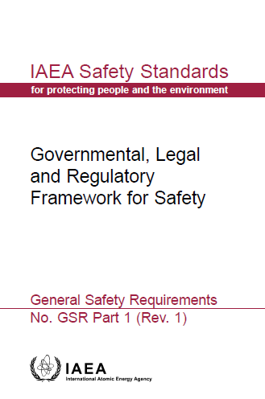
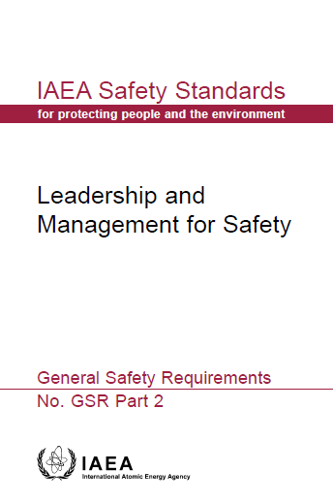
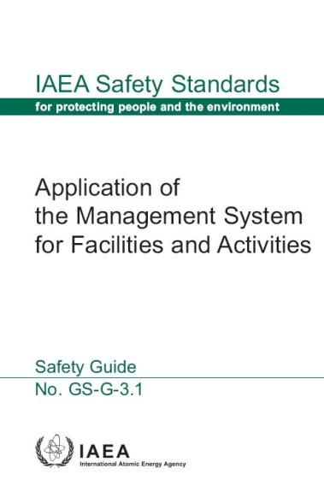
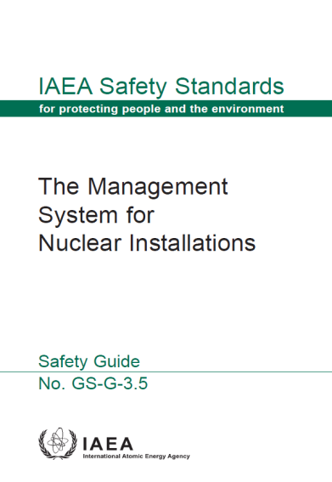
IAEA Safety Standards
SAFETY FUNDAMENTALS
Effective leadership and management for safety must be established and sustained
SAFETY REQUIREMENTS
Safety shall be paramount within the management system
SAFETY GUIDES
Provide guidance for management system implementation and sustainability
Provide basis for developing and implementing Leadership and Management System for Regulatory Body
07-18 May - 18-29 June 2018
Notes:
From SF-1 |Principle 3] Principle 3 of the IAEA’s Fundamental Safety Principles, on Leadership and Management for Safety, states that “Effective leadership and management for safety must be established and sustained in organizations concerned with, and facilities and activities that give rise to, radiation risks.”
[From GSR Part 2 |Para 4 and GSR Part 2 R3]. Senior managers are responsible for establishing, applying, sustaining and continuously improving a management system, so that all work(or activity) at a facility is carried out safely.
Governmental, Legal and Regulatory Framework for Safety – GSR Part 1 also talks about the Management System. Among responsibilities and functions of the Government, the global safety regime and responsibilities and functions of the regulatory body; it talks about the Management System.
Specifically, Requirement 19 – The Management System of the Regulatory Body: The regulatory body shall establish, implement, assess and improve a management system that is aligned with its safety goals and contributes to their achievement.

Slide 12
IAEA Safety Standards
  GSR Part 1 Governmental, Legal and Regulatory Framework for safety
    Requirement 16 The regulatory body shall structure its organisation and manage its resources so as to discharge its responsibilities and perform its functions effectively
  Requirement 19 The regulatory body shall establish, implement, assess and improve a management system that is aligned with its safety goals and contributes to their achievement
  Requirement 34: Promotion of regulations and guides to interested parties
  Requirement 36: Communication and consultation with interested parties
07-18 May - 18-29 June 2018
Notes:
[GSR Part 1 Rev1 |R19].
Implementation of IMS has Three Purposes
first purpose is to ensure that the responsibilities assigned to the regulatory body are properly discharged;
second purpose is to maintain and improve the performance of the regulatory body by means of planning, control and supervision of its safety related activities.
third purpose is to foster and support a safety culture in the regulatory body through the development and reinforcement of leadership, as well as good attitudes and behaviour in relation to safety on the part of individuals and teams.
[From GSR Part 2 |Para 4 and GSR Part 2 R3]. Senior managers are responsible for establishing, applying, sustaining and continuously improving a management system, so that all work(or activity) at a facility is carried out safely.
Regulation functions include:
Drafting regulations and guides
Licensing
Review and assessment
Inspection and enforcement…

Slide 13

IAEA Safety Standards - GSR Part 2
GSR Part 2 Establishes requirements for a safety focused, Management for safety, Leadership for safety and safety culture
  Supports achievement of general aims of management for safety to demonstrate leadership for safety and to improve safety performance of the organization by fostering a strong safety culture
Achieving the fundamental safety objective
Leadership for Safety
Process Implementation
Measurement, Assessment and Improvement
Responsibility of Management
Management of Resources
Effective management for safety
Proper consideration of ITO
Safety Culture
Leadership for safety and management for safety are to be developed together and integrated so that all individuals in an organization are involved and are committed to safety and regulatory performance
07-18 May - 18-29 June 2018
Notes:
[From SF-1 |Principle 3] Principle 3 of the IAEA’s Fundamental Safety Principles, on Leadership and Management for Safety, states that “Effective leadership and management for safety must be established and sustained in organizations concerned with, and facilities and activities that give rise to, radiation risks.”
[From GSR Part 2 |Para 4 and GSR Part 2 R3]. Senior managers are responsible for establishing, applying, sustaining and continuously improving a management system, so that all work(or activity) at a facility is carried out safely.
Regulation functions include:
Drafting regulations and guides
Licensing
Review and assessment
Inspection and enforcement…

Slide 14
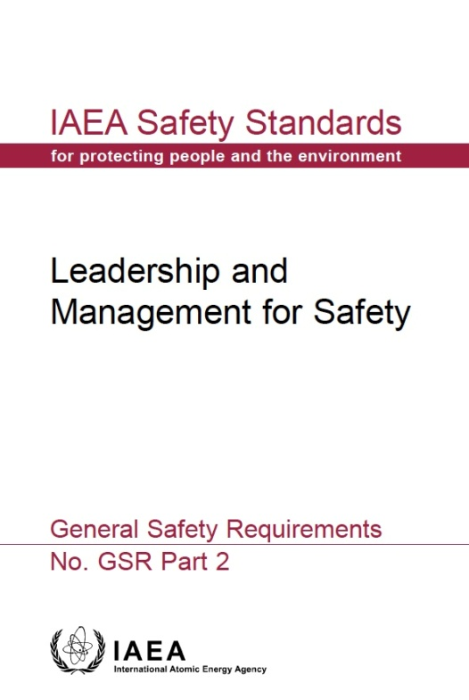
GSR Part 2 Leadership & Management for Safety
R1: Achieving the fundamental safety objective
Responsibility for Safety
Responsibility for Integration of Safety into the Management System
R2: Demonstration leadership for safety by managers
Leadership for Safety
Culture for Safety
R12: Fostering a culture for safety
Management for Safety
R3: Responsibility of Senior Management for the Management System
Measurement, Assessment and Improvement
R13: Measurement, assessment and improvement of the management system
R4: Goals, strategies, plans and objectives
R14: Measurement, assessment and improvement of the management system
R5: Interaction with interested parties
Management of Processes and Activities
R6: Integration of the Management System
R7: Application of the Graded Approach
R8: Documentation of the Management System
The Management System
Management of Resources
R9: Provision of Resources
R10: Management of Processes and Activities
R11: Management of the Supply Chain
Management of Processes and Activities
07-18 May - 18-29 June 2018
Notes:
2. RESPONSIBILITY FOR SAFETY
Requirement 1: Achieving the fundamental safety objective
3. LEADERSHIP FOR SAFETY .
Requirement 2: Demonstration of leadership for safety by managers
4. MANAGEMENT FOR SAFETY
Responsibility for integration of safety into the management system
Requirement 3: Responsibility of senior management for the management system
Requirement 4: Goals, strategies, plans and objectives
Requirement 5: Interaction with interested parties
Requirement 6: Integration of the management system
Requirement 7: Application of the graded approach to the management system
Requirement 8: Documentation of the management system
Management of resources
Requirement 9: Provision of resources
Management of processes and activities
Requirement 10: Management of processes and activities
Requirement 11: Management of the supply chain
5. CULTURE FOR SAFETY
Requirement 12: Fostering a culture for safety
6. MEASUREMENT, ASSESSMENT AND IMPROVEMENT
Requirement 13: Measurement, assessment and improvement of the management system
Requirement 14: Measurement, assessment and improvement of leadership for safety and of safety culture

Slide 15

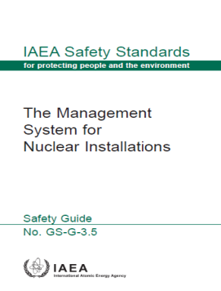
IAEA Safety Guides – GS G 3.1 & 3.5
Generic Safety Guidance GS-G-3.1
  Application of the Management System for Facilities and Activities (application of GS R Part 2 requirements)
  IAEA Thematic guidance for Management Systems
  Generic information and examples to aid understanding and implementation of Management System requirements
  Provides guidance on HOW TO comply with GSR Part 2 requirements:
  Generic Safety Guidance GS-G-3.5
  Provides guidance for the application of GSR Part 2 requirements at nuclear facilities
  Provides supplementary guidance to GS-G-3.1 and extends the guidance in GS-G-3.1 topics except for: Management commitment, Planning, Process management and Management system review
07-18 May - 18-29 June 2018

Slide 16
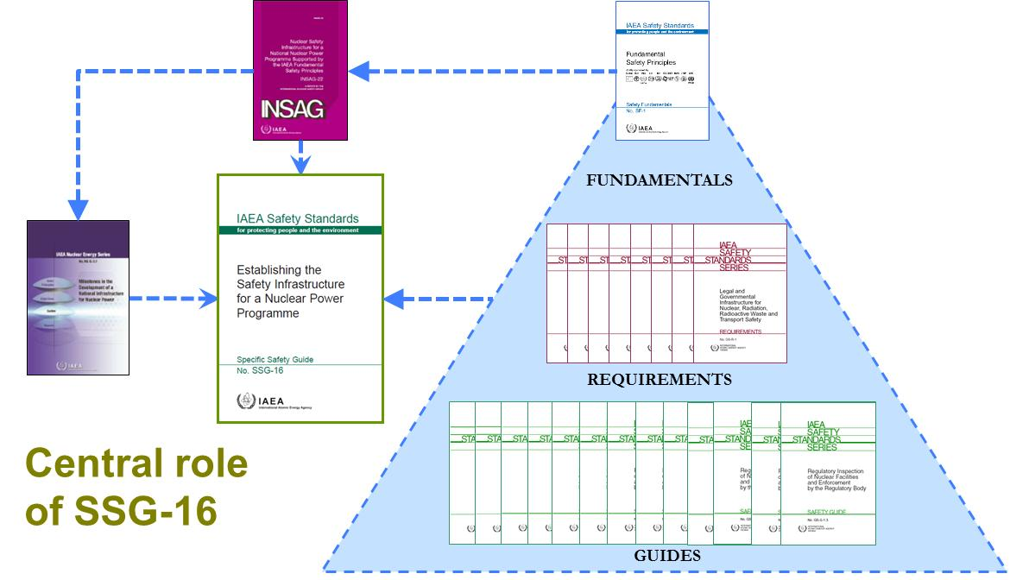
SSG 16- Overview for Establishing a Safety Infrastructure
Safety guide SSG-16 Establishing the Safety Infrastructure for a Nuclear Power Programme constitutes a “Road-map” to apply the entire suite of IAEA Safety Standards progressively during the early phases of the implementation of a nuclear power programme.
Intended to contribute to build leadership and management for safety, and safety culture amongst the involved organisations, including regulatory bodies
Leadership and Management for Safety
07-18 May - 18-29 June 2018
Notes:
SSG 16
2.144. Efficient and effective management systems constitute a cross-cutting element of the safety infrastructure, applicable for all the organizations involved in the nuclear power program. However, the extent of involvement of the different organizations will vary considerably during the different phases of implementation of the nuclear power program. Government is the major player in Phase 1
2.145. All the actions taken by the relevant organizations should be included in the framework of an effective management system. In this regard, the requirements stated in GSR Part 2 should provide the basis for the implementation of integrated management systems.

Slide 17
SSG 16- Implementing Integrated Management System
  SSG-16 Actions 72-84 provide recommendations for building of leadership for safety, management for safety and a culture for safety amongst the involved organisations in nuclear power programme
Ready to make a knowledgeable commitment to a nuclear programme
Ready to invite bids
Ready to commission and operate the first NPP
Phase 1
Phase 2
Phase 3
Role of the Government
Action 72, 73, 74
Implementation of the Regulatory Body
Action 78, 82
Action 75, 76, 77
Implementation of the Operating Organization
Action 78, 79, 80, 81, 82
Action 75, 76
M1
M2
M3
07-18 May - 18-29 June 2018
17
Notes:
The picture shows the role of the main entities during different phases of safety infrastructure development for the establishment of Leadership for safety, management for safety and culture for safety
Phase 1
Action 72. The government should take into account the essential role of leadership and management for safety to achieve a high level of safety and to foster safety culture within organizations.
Action 73. The government should ensure that all the activities conducted are included within the framework of an effective management system.
Action 74. The government, when identifying senior managers for the prospective organizations to be established, should look for persons with leadership capabilities and an attitude emphasizing safety culture.
Phase 2
Action 75. The regulatory body … should start developing and implementing effective management systems in their respective organizations and should promote a strong safety culture.
Action 76. The regulatory body … should develop competences in managing the growth of and change in the organization.
Action 77. The regulatory body and the operating organization should make appropriate arrangements for measurement, assessment (both ‘self-assessment’ and independent assessment) and continuous improvement of their management systems.
Phase 3
Action 78. The senior management of the regulatory body should provide effective leadership and effective management for safety to ensure a sustainable high level of safety and a strong safety culture.
Action 79. All the relevant organizations should continue the implementation of a management system that promotes the concept that requirements for safety shall be paramount within the organization, overriding all other demands.
Action 80. The operating organization and the regulatory body should ensure that the effectiveness of their management systems is monitored and measured, and that self-assessments as well as independent assessments are conducted regularly for continuous improvement.
Action 81. All the relevant organizations should ensure that appropriate arrangements for management of safety related knowledge (including record management and report management) and knowledge transfer are in place.
Action 82. The regulatory body should ensure that leadership and succession development programmes are in place to develop future leaders with a strong emphasis on safety.
Action 84. The regulatory body should review and assess the operating organization’s program on safety management.

Slide 18
SSG 16- Implementing Integrated Management System
decision
call for tenders
commissioning
Phase 1
Phase 2
Phase 3
Government (Only)
Consideration of the importance of leadership and management for safety and to foster safety culture
Identification of senior managers with leadership capabilities and an attitude emphasizing safety culture
Regulatory Body
Development and implementation of integrated management system [IMS]
Promotion of safety culture
Continuous improvement mechanisms
Competences in managing growth and organization change
07-18 May - 18-29 June 2018

Slide 19
SSG 16- Implementing Integrated Management System
decision
call for tenders
commissioning
Phase 1
Phase 2
Phase 3
Continuation to implement Integrated Management System promoting Safety and Safety Culture
Effectiveness and continuous improvement of IMS
Management and transfer of safety related knowledge
Leadership and succession development
Regulatory oversight of operator’s programme on safety management
Effective leadership and effective management for safety
07-18 May - 18-29 June 2018

Slide 20
GSR Part 2- Leadership, Management for Safety, Safety Culture
GSR Part 2- supersedes IAEA Safety Standards Series GS-R-3 on the Management System for Facilities and Activities;
It takes into account lessons drawn from experience in events that have occurred; such as in Fukushima Daiichi accident;
leadership, management for safety, and safety culture are critical to ensuring safety……five major recurrent issues in accidents and incidents are leadership, communication, operational attitudes and behavior, risk management and oversight;
It emphasizes that leadership for safety, management for safety, an integrated management system and a systemic approach (i.e. ITO) are essential to the specification and application of adequate safety measures and the fostering of a strong safety culture.
  GSR Part 2 | 1.2
07-18 May - 18-29 June 2018
Notes:
Senior management has a significant role in making the management system work and must develop both individual and institutional values and behavioural expectations for the organisation
Senior management are expected to lead the way and illustrate through their words and actions the importance of the management system.
Managers at all levels have an obligation to communicate the importance of implementing the management system in all work situations and to follow-up compliance;
Allowing unsuitably qualified personnel to work on safety-related jobs can have severe consequences both in terms of accident risks and with respect to sending a wrong signal from management about what is being prioritised, safety or production.
Management should ensure that the workforce have been provided with adequate training, resources and direction so that work can be performed safely and effectively.

Slide 21
Management for Safety- Integrated Management System
Responsibility for integration of safety into the Management System
Requirement 3: Responsibility of senior management for the management system
Senior management shall be responsible for establishing, applying, sustaining and continuously improving a management system to ensure safety.
4.1. Senior management shall retain accountability for the management system even where individuals are assigned responsibility for coordinating the development, application and maintenance of the management system
4.2. Senior management shall be responsible for establishing safety policy.
GSR Part 2 | 4.1, 4.2
07-18 May - 18-29 June 2018
Notes:
The effectiveness of a management system begins with senior management responsibility for:
establishment, implementation, assessment and continual improvement of the management system, and providing adequate resources to carry out these activities;
developing goals, strategies, plans and objectives which do not compromise safety by other priorities;
ensuring that the workforce have been provided with adequate training, resources and direction so that work can be performed safely and effectively.
Senior management shall be responsible for establishing, applying, sustaining and continuously improving a management system to ensure safety.
4.1. Senior management shall retain accountability for the management
system even where individuals are assigned responsibility for coordinating the
development, application and maintenance of the management system
4.2. Senior management shall be responsible for establishing safety policy.

Slide 22
Management for Safety- Integrated Management System
Requirement 4: Goals, strategies, plans and objectives
“Senior management shall establish goals, strategies, plans and objectives for the organization that are consistent with the organization’s safety policy”
Measurable goals, strategies, plans and objectives for the organization at various levels shall be developed in a manner that safety has the overriding priority, should be periodically reviewed and actions taken to address any deviations.
GSR Part 1 (Rev 1) Requirement 19: The management system of the regulatory body
“The regulatory body shall establish, implement, and assess and improve a management system that is aligned with its safety goals and contributes to their achievement.”
07-18 May - 18-29 June 2018
Notes:
Requirement 4: Goals, strategies, plans and objectives.
Senior management shall establish goals, strategies, plans and objectives for the organization that are consistent with the organization’s safety policy.
4.3. Goals, strategies, plans and objectives for the organization shall be developed in such a manner that safety is not compromised by other priorities.
4.4. Senior management shall ensure that measurable safety goals that are in line with these strategies, plans and objectives are established at various levels in the organization.
4.5. Senior management shall ensure that goals, strategies and plans are periodically reviewed against the safety objectives, and that actions are taken where necessary to address any deviations.

Slide 23
Management for Safety- Integrated Management System
Requirement 5: Interaction with Interested Parties
“Senior management shall ensure that appropriate interaction with interested parties takes place”
“Senior management shall provide means for communicating effectively with interested parties on necessary information relevant to safety and considering concerns and expectations of interested parties in relation to safety”.
GSR Part 1 (Rev 1) Requirement 34: Promotion of regulations and guides to interested parties
“The regulatory body shall notify interested parties and the public of the principles and associated criteria for safety established in its regulations and guides, and shall make its regulations and guides available”.
GSR Part 1 (Rev 1) Requirement 36: Communication and consultation with interested parties
“The regulatory body shall promote the establishment of appropriate means of informing and consulting interested parties and the public about the possible radiation risks associated with facilities and activities, and about the processes and decisions of the regulatory body”.
07-18 May - 18-29 June 2018
Notes:
Senior management responsibilities:
[From GSR Part 2 |R5]. Interaction with interested parties senior management shall ensure that appropriate interaction with interested parties takes place.
4.6. Senior management shall identify interested parties for their organization and shall define an appropriate strategy for interaction with them.
4.7. Senior management shall ensure that the processes and plans resulting from the strategy for interaction with interested parties include:
(a) Appropriate means of communicating routinely and effectively with and informing interested parties with regard to radiation risks associated with the operation of facilities and the conduct of activities;
(b) Appropriate means of timely and effective communication with interested parties in circumstances that have changed or that were unanticipated;
(c) Appropriate means of dissemination to interested parties of necessary information relevant to safety;
(d) Appropriate means of considering in decision making processes the concerns and expectations of interested parties in relation to safety.

Slide 24
Management for Safety- Integrated Management System
The Management System
  Requirement 6: Integration of the management system “The management system shall integrate its elements, including safety, health, environmental, security, quality, human-and-organizational-factor, societal and economic elements, so that safety is not compromised”.
The management system aligned with the safety goals shall be developed, applied and continuously improved to foster a strong safety culture.
  Requirement 7: Application of the graded approach to the management system “The management system shall be developed and applied using a graded approach”.
  Requirement 8: Documentation of the management system “The management system shall be documented. The documentation of the management system shall be controlled, usable, readable, clearly identified and readily available at the point of use.”
07-18 May - 18-29 June 2018
Notes:
Control of documents is a prerequisite for a management system to function. All individuals involved in preparing, revising, reviewing or approving documents shall be competent to carry out the assessments and have access to appropriate information on which they can base their decisions. It is a good idea to use a mixture of personnel to ensure that managerial, administrative and technical aspects are taken into account. Changes to documents shall be reviewed and recorded systematically for traceability and shall be subject to approval.

Slide 25
Management for Safety- Integrated Management System
Management of Resources
Requirement 9: Provision of Resources “Senior management is responsible to determine the necessary internal and external available competences and resources to discharge its responsibilities.
The individuals at all levels should have required competences and should be trained; evaluation of the effectiveness of the training is also monitored and assessed”
Management of Processes and Activities
Requirement 10: Management of processes and activities “Processes and activities shall be developed and effectively managed to achieve the organization’s goals without compromising safety”.
Effective interaction between interfacing processes should be determined. Processes should follow documented procedures and instructions, periodically reviewed and validated to ensure their adequacy and effectiveness. Results of the processes should be recorded...
07-18 May - 18-29 June 2018
Notes:
Senior management responsibilities:
[From GSR Part 2 |R9]. Requirement 9: Provision of Resources
Senior management shall determine the competences and resources
necessary to carry out the activities of the organization safely and shall
provide them.
4.21. Senior management shall make arrangements to ensure that the organization has in-house, or maintains access to, the full range of competences and the resources necessary to conduct its activities and to discharge its responsibilities
for ensuring safety at each stage in the lifetime of the facility or activity, and during an emergency response
4.22. Senior management shall determine which competences and resources the organization has to retain or has to develop internally, and which competences and resources may be obtained externally, for ensuring safety.
4.23. Senior management shall ensure that competence requirements for individuals at all levels are specified and shall ensure that training is conducted, or other actions are taken, to achieve and to sustain the required levels of
competence. An evaluation shall be conducted of the effectiveness of the training and of the actions taken.

Slide 26
Management for Safety
Measurement, Assessment and Improvement
Requirement 13: Measurement, assessment and improvement of the
management system
“The effectiveness of the management system shall be measured, assessed and improved to enhance safety performance, including minimizing the occurrence of problems relating to safety”
Independent assessments and self-assessments of the management system shall be regularly conducted to evaluate its effectiveness and to identify opportunities for its improvement.
Lessons and any resulting significant changes shall be analyzed for their implications for safety.
07-18 May - 18-29 June 2018
Notes:
Senior management responsibilities:
[From GSR Part 2 |R9]. Requirement 9: Provision of Resources
Senior management shall determine the competences and resources
necessary to carry out the activities of the organization safely and shall
provide them.
4.21. Senior management shall make arrangements to ensure that the organization has in-house, or maintains access to, the full range of competences and the resources necessary to conduct its activities and to discharge its responsibilities
for ensuring safety at each stage in the lifetime of the facility or activity, and during an emergency response
4.22. Senior management shall determine which competences and resources the organization has to retain or has to develop internally, and which competences and resources may be obtained externally, for ensuring safety.
4.23. Senior management shall ensure that competence requirements for individuals at all levels are specified and shall ensure that training is conducted, or other actions are taken, to achieve and to sustain the required levels of
competence. An evaluation shall be conducted of the effectiveness of the training and of the actions taken.

Slide 27
Summary
IAEA standards on management system are:
  Easily applicable to a wide range of facilities and activities, including those of a regulatory body
  More comprehensive and integrated requirements while keeping safety paramount
  Aligned with state of the art international management system standards
    Integration means incorporation of the all the requirements in the processes, also those derived from the expectation of the interested parties
    Grading the application of the management system requirements enables that valuable resources and priorities can be targeted at the activities of greater safety significance
    Measurement, assessment and improvement program enables effective implementation of integrated management system
07-18 May - 18-29 June 2018
Notes:
Integration means incorporation of all the requirements in the processes, also those derived from the expectation of the interested parties for managing the activities and processes

Slide 28
Questions 10-15 minutes discussion
List the relevant IAEA Safety Standards related to leadership, management for safety and safety culture for the nuclear power program.
What does integration mean for implementing Management System in an organization?
What are the basic elements necessary to consider when implementing Integrated Management System?
What is a process?
07-18 May - 18-29 June 2018
Notes:
Review questions for 10-15 minutes discussion :
Q1. List the relevant IAEA Safety Standards related to leadership, management for safety and safety culture for the nuclear power program
A. SF 1, GS R Part 1, GS R Part 2, GS G 3.1, GS G 3.5, SSG 16
Q2. What does integration mean for implementing Management System in an organization
A. Bringing together in a coherent manner all the necessary elements for safely managing the organization and its activities; Integration means incorporation of all the requirements in the processes, also those derived from the expectation of the interested parties for managing the activities and processes
Q3. What are the basic elements necessary to consider when implementing Integrated Management System
Appropriate resources, competencies, leadership, attitude and behavior towards safety
Q4. What is a process?
A process is an integrated set of activities that uses resources to transform inputs into outputs
.

Slide 29
Key points
GSR Part 2 supersedes GSR 3, it provides requirements for Leadership and Management for Safety and Safety Culture;
Inadequate management systems often are major contributors to accidents and incidents at a nuclear installation;
The five major recurrent issues in accidents and incidents are leadership, communication, operational attitudes and behaviour, risk management and oversight;
When establishing the national infrastructure for safety, the regulatory body should develop and implement its integrated management system to effectively discharge the regulatory functions
Management System integrates safety, health, security, environmental and quality objectives

Slide 30
List of abbreviations
IMS- Integrated Management System
INSAG – International Nuclear Safety Advisory Group
GSR – General Safety Requirement
GSG – General Safety Guide
SSG – Specific Safety Guide
07-18 May - 18-29 June 2018

Slide 31
References
International Atomic Energy Agency, Fundamental Safety Principles, Safety Standards Series No. SF-1, IAEA, Vienna (2006).
International Atomic Energy Agency, Governmental, Legal and Regulatory Framework For Safety, IAEA Safety Standards Series No. GSR Part 1 (Rev. 1), IAEA, Vienna (2016).
International Atomic Energy Agency, Safety Requirements No. GSR Part 2, Leadership and Management for Safety (2016).
International Atomic Energy Agency, Application of The Management System for Facilities and Activities, Safety Guide No. GS-G-3.1, IAEA, Vienna (2006).
International Atomic Energy Agency, The Management System for Nuclear Installations, Safety Guide No. GS-G-3.5, IAEA, Vienna (2009).
Thank you!
Notes:
Thank you!

